Slide 1

Hacktiv8
Paragon Sales Forecasting
Predicting Paragon Sales by using Time-Series Analysis Forecasting?
Gabriel Reyes
April 2023
Hacktiv8

Slide 2




Executive Summary (I/II)
1
PT. Paragon Technology and Innovation
Paragon is one of the leading Beauty Products FMCG company in Indonesia
Founded in 1985 as PT. Pusaka Tradisi Ibu, released their first brand “Putri”
Paragon owned many well-known brand, such as Wardah, MakeOver, Emina, Kahf
Paragon has 41 distribution centres, 200 CSR Partners, and >1600 SKU
2
Beauty and Personal Care Outlook in Indonesia
Beauty & Personal Care's revenue will reach US$7.95 billion by 2023. The market is expected to grow annually by 4.80% (CAGR 2023-2027).
The largest market segment is the Personal Care segment, with a market volume of US$3.41 billion in 2023.
In the Beauty & Personal Care market, 18.9% of total revenue will be generated through online sales by 2023.
3
This modelling aims to forecast the Sales performance of Paragon
The modelling will be using Time Series Analysis method, which forecasting the performance based on historical performance
The model will give insight towards the Business Development department to create a strategic business decision onwards
Hacktiv8

Slide 3
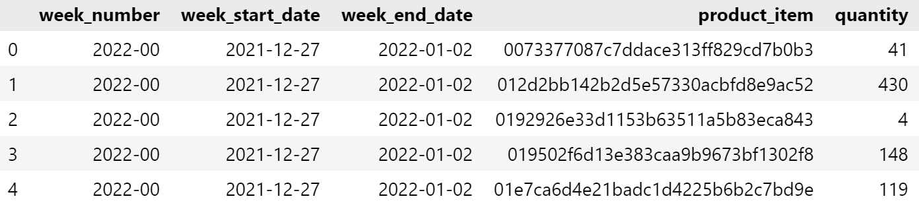
Executive Summary (II/II)
4
Dataset
102.733 entries of data with 5 columns :
Week_number
Week_start_date
Week_end_date
Product_item
Quantity
Week_number : Week of specific product sold
Week_start_date : Start date of specific product sold
Week_end_date : End date of specific product sold
Product_item : Product Code
Quantity : Quantity in respective week
Hacktiv8

Slide 4

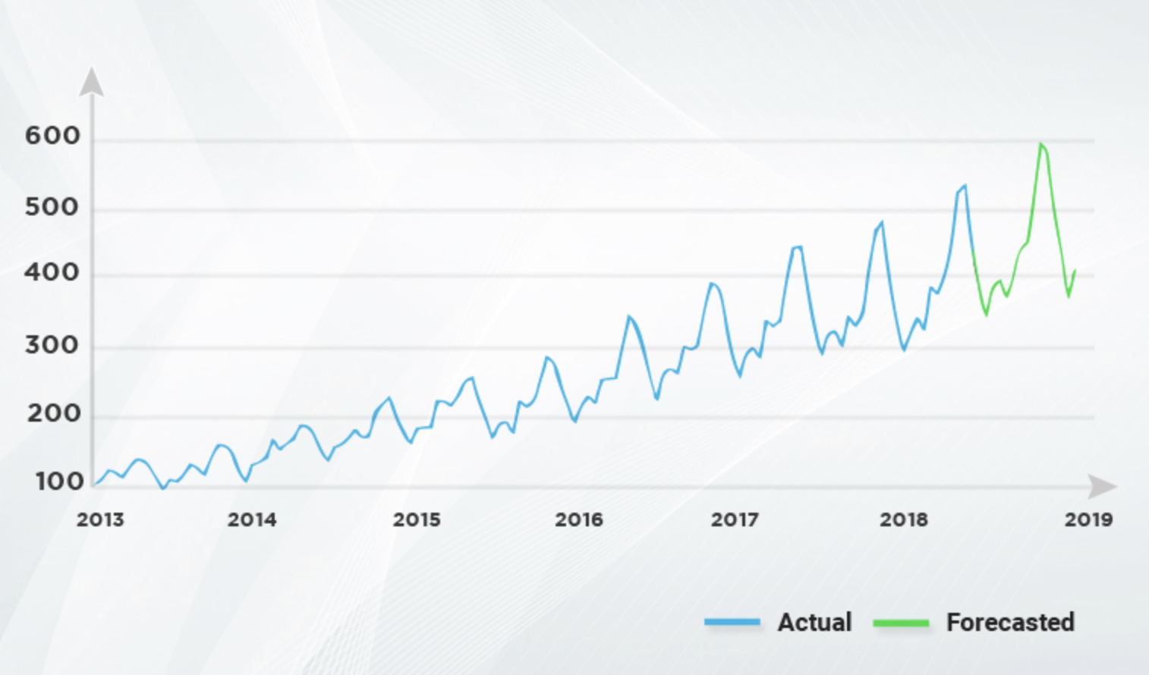
Sales Performance Sales forecasting in Time Series Analysis
0
According to Brockwell in International Encyclopedia of Education
Time series analysis has many different objectives:
Forecasting future values of the series,
Extracting a signal hidden in noisy data,
Discovering the mechanism by which the data are generated,
Simulating independent realizations of the series to see how it might behave in the future.
Business benefits for Paragon :
Forecast Future Sales,
Improve Inventory Management,
Improve Resource Allocation,
Create Marketing Strategies
Hacktiv8

Slide 5
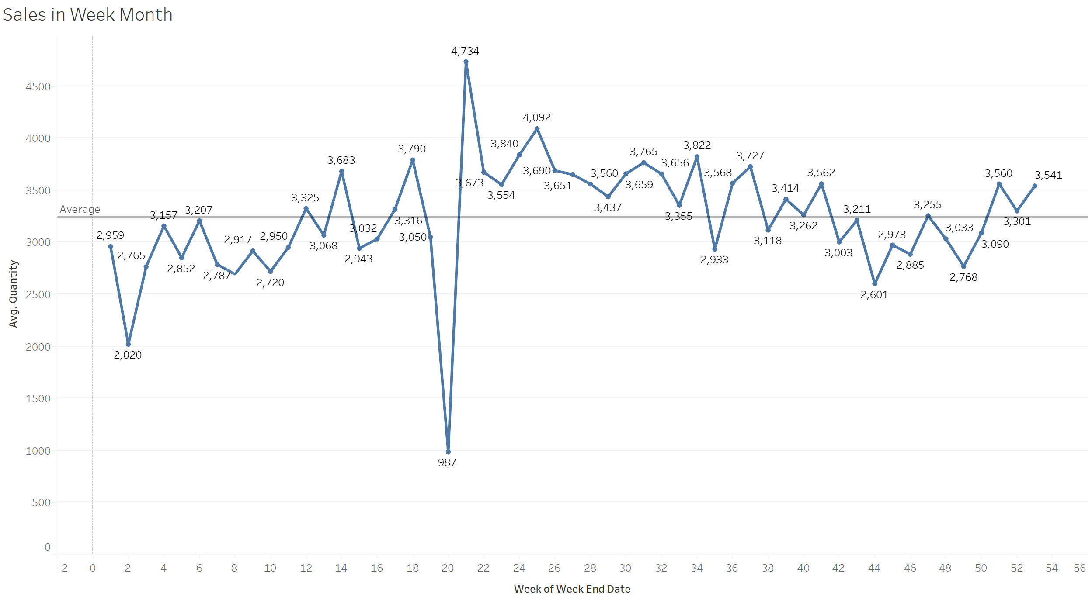
Overview Sales Performance in Week Month
0
In week month…
Are evenly performed above and under the average line
Week 20 has the worst sales performance
Week 21 has the best sales performance
The biggest drop of sales performance occurred from week 19-20
The biggest increase of sales occurred on week 20-21
Hacktiv8

Slide 6
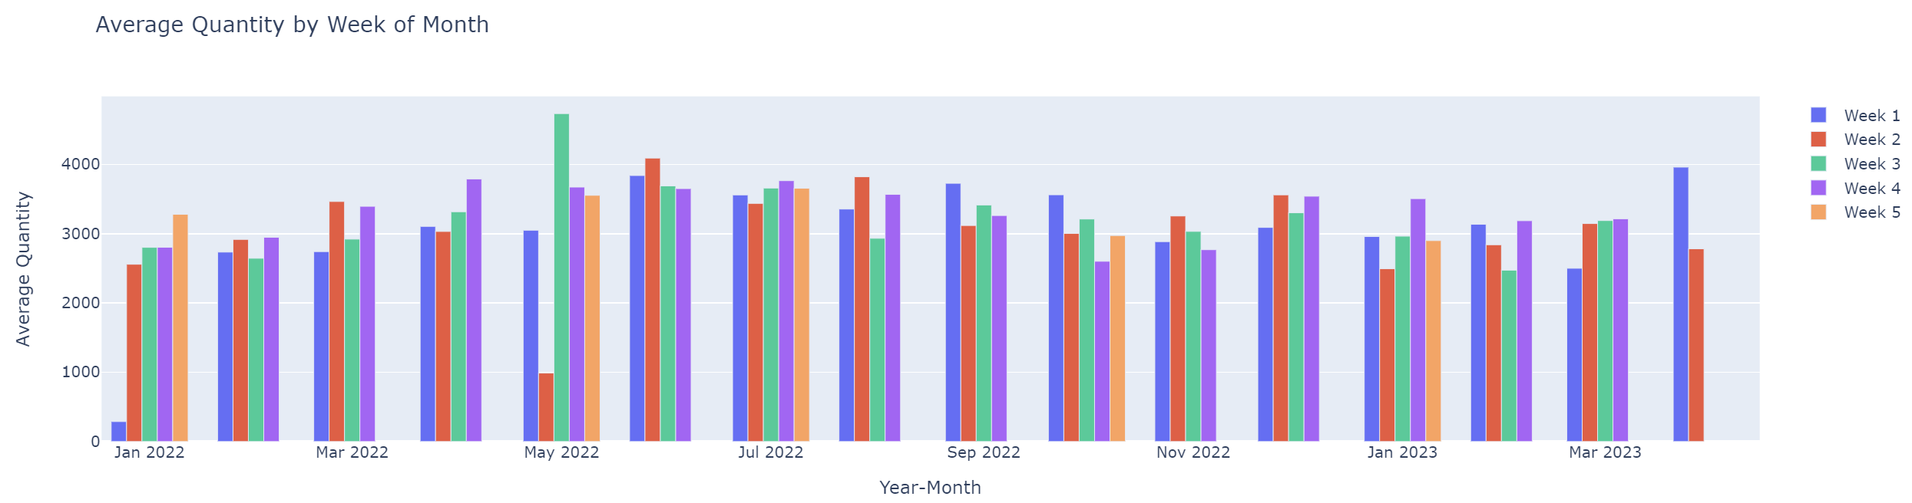
Sales Performance Sales Performance in Week in a Month
1
In week in a month…
Overall, there are no significant difference in sales for early or late week
May 2022 has a significant difference between the Week 2 & Week 3
Evenly distributed for the Late week outperform the early week sales performance. Vice versa
Hacktiv8

Slide 7
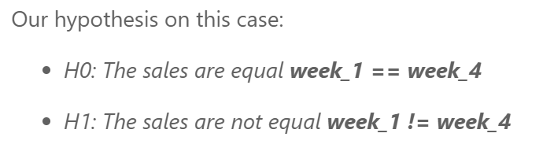

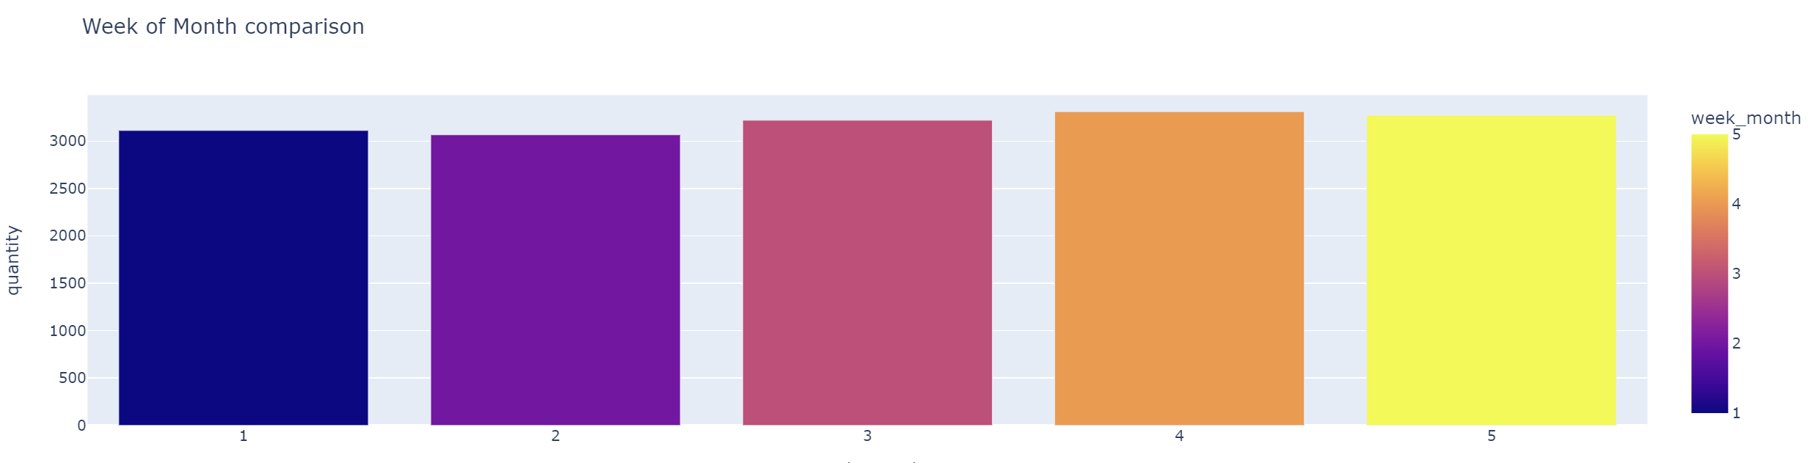
Statistically Significant The performance of the Early and Late week are not statistically significant
2
Paired t-test
Result
A paired t-test, also known as a dependent t-test, is a statistical test used to compare the means of two related samples. The same group of participants is tested under two different conditions or when two measurements are taken on the same subject at different times.
Since the p-value is more than 0.05, we conclude that we fail to reject the Null Hypothesis which means the quantity sold in week 1 and week 4 is statistically not significant.
Hacktiv8

Slide 8
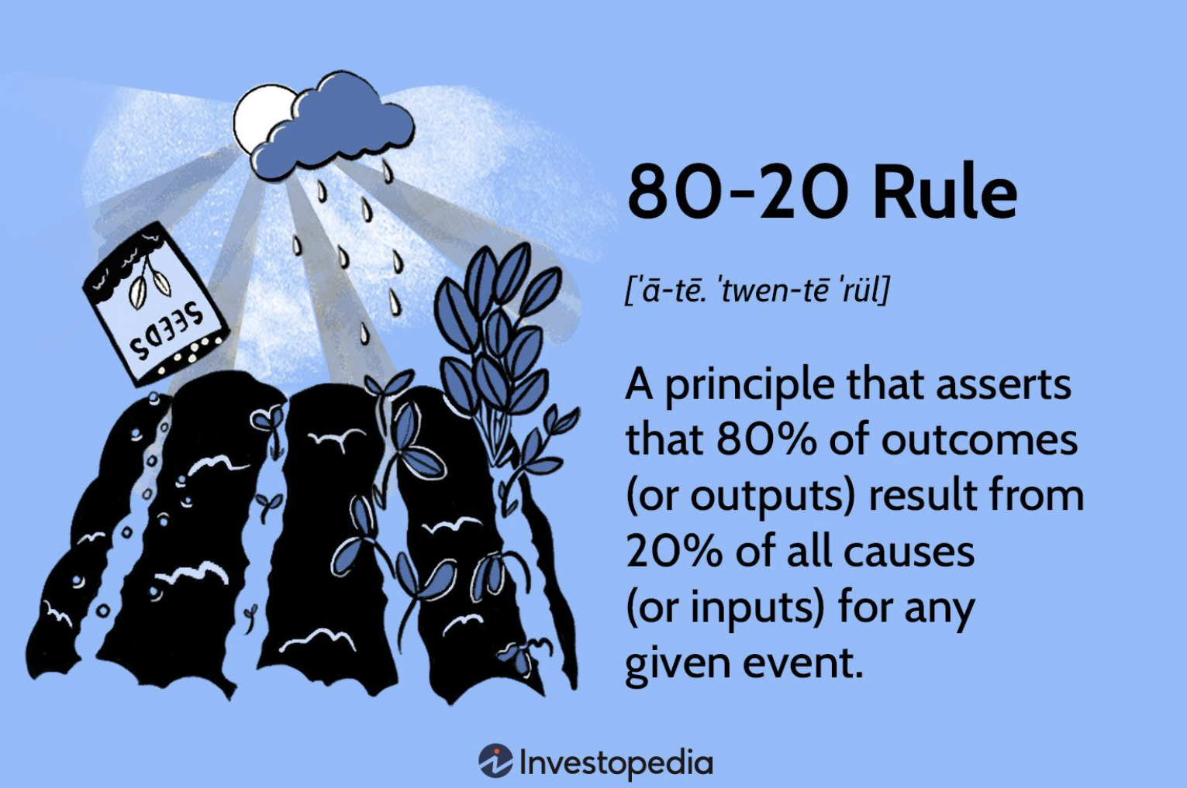
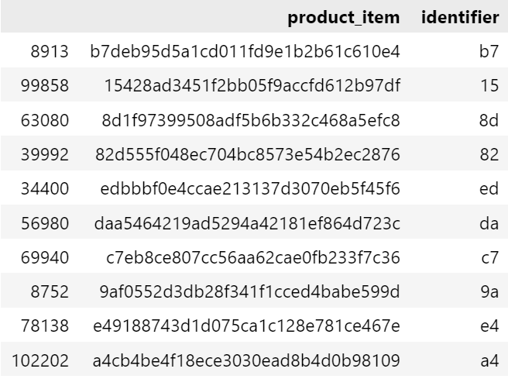
Product Items SKU Code and Pareto Analysis
3
SKU
Pareto Principle
A number (usually eight alphanumeric digits) that retailers assign to products to keep track of stock levels internally.
The 80-20 rule, also known as the Pareto Principle, is a familiar saying that asserts that 80% of outcomes (or outputs) result from 20% of all causes (or inputs) for any given event.
The beginning of each SKU should represent a top-level identifier in 2-3 characters. Top-level identifiers can be a department or product category
2309 Product Id
256 Top Level-Identifier
Hacktiv8

Slide 9
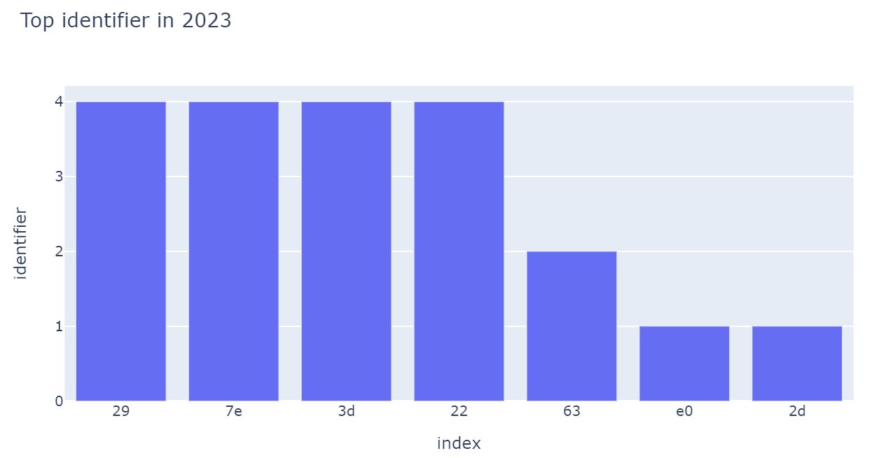
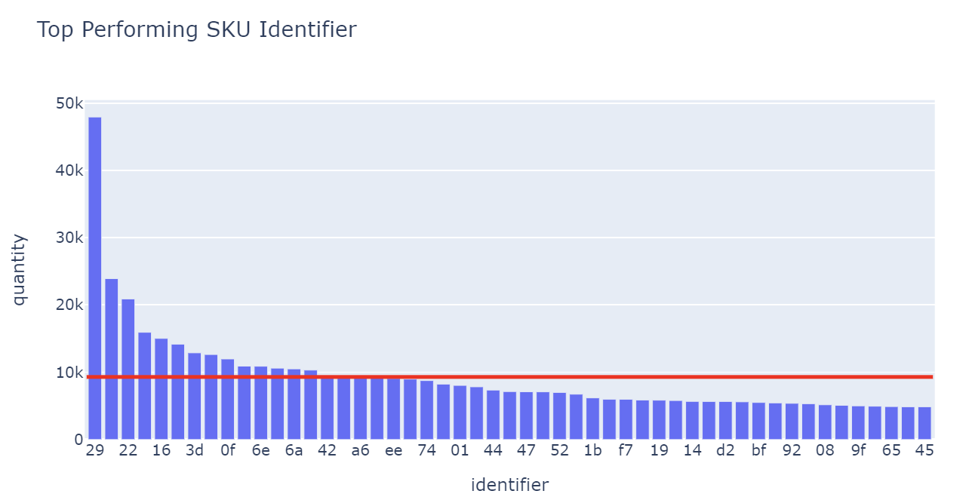
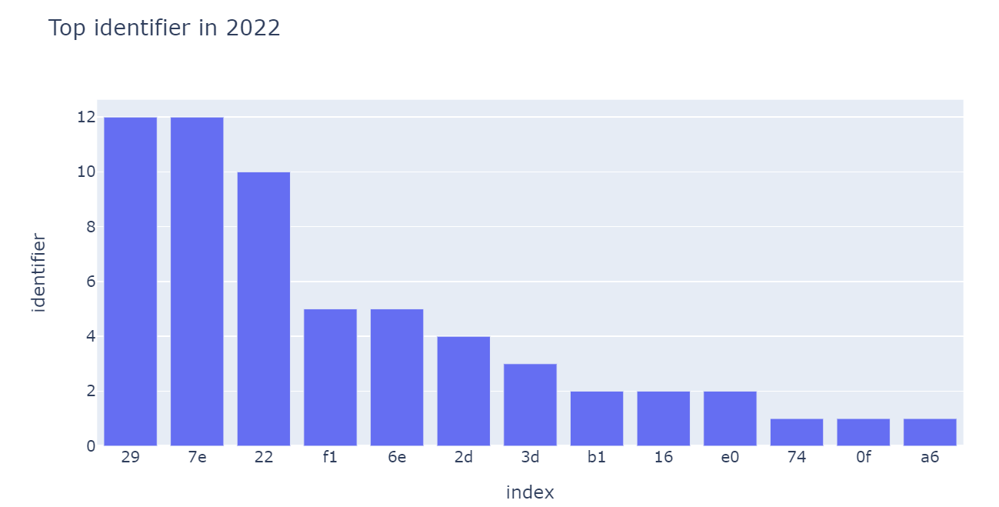
Product Items Top 20% identifier accounted 59% of total sales
4
Pareto Analysis
Top 20% identifier accounted 59% of total sales from 2022-2023
Top 5 identifier overall :
29 : 47940 unit
7e : 23908 unit
22 : 20886 unit
2d : 15925 unit
16 : 15019 unit
Hacktiv8

Slide 10
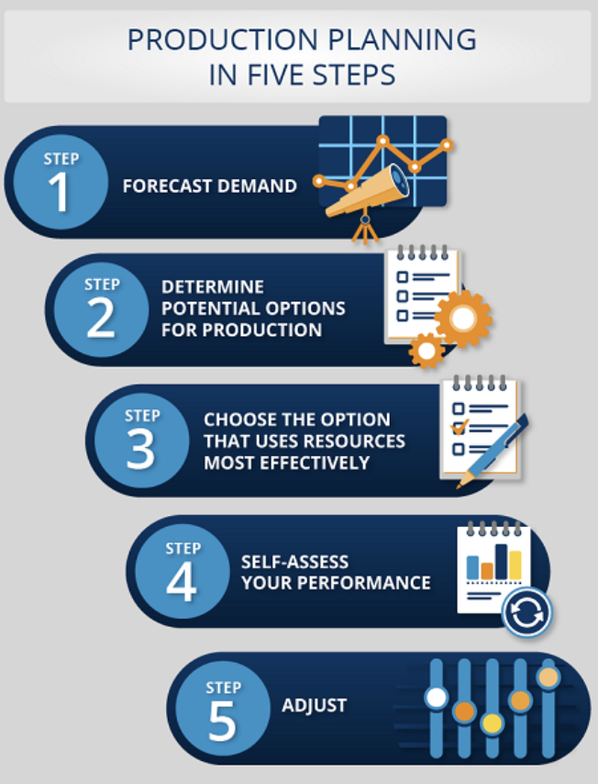
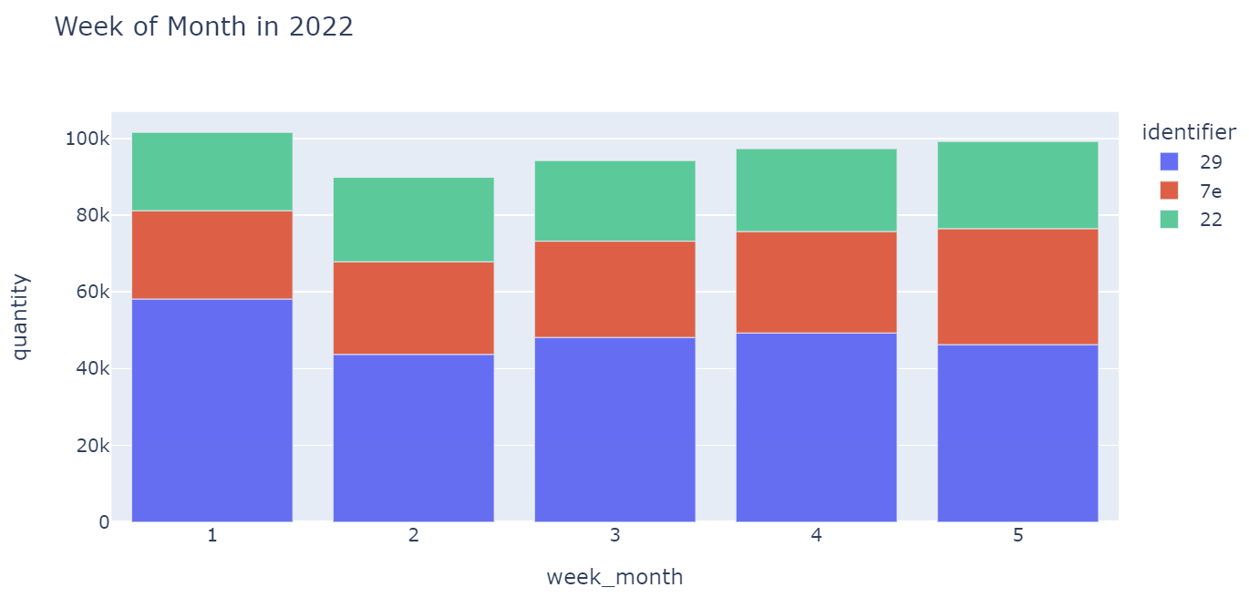
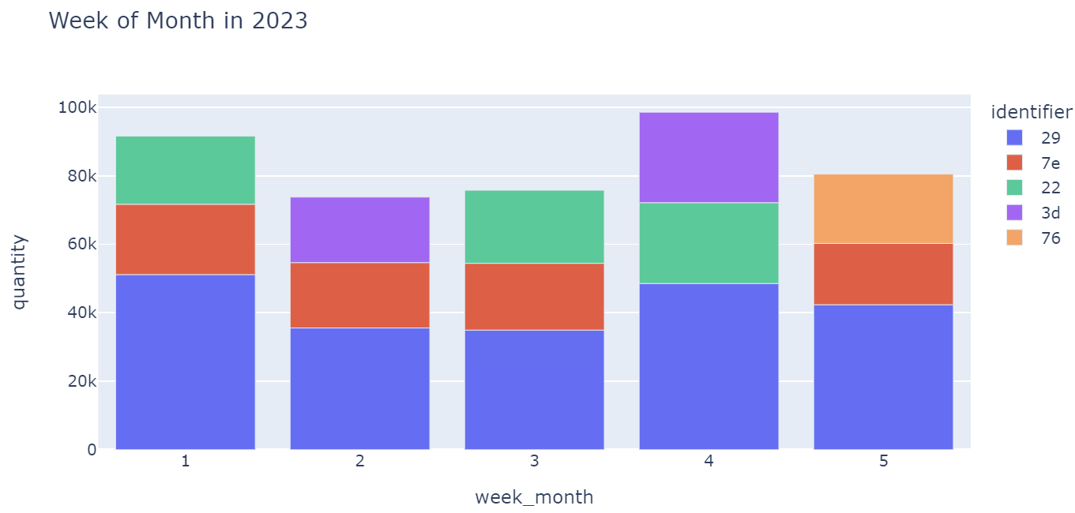
Production Planning Weekly Production Planning based on Pareto Analysis
5
Production Planning
Optimal production planning may affect the reduction of the production cost or production downtimes and the minimization of waste and the energy consumption.
Top Priority for Production :
29, 7e, and 22
Further analysis for the emerging products :
3d, 76
Hacktiv8

Slide 11

Model Building Feature Checking and Handling
6
Feature Checking & Handling
Handling Features before piped into the model
Duplicated Value
Missing Value
Outlier Value
Stationary Checking
Summary Statistics
Augmented Dickey-Fuller (ADCF)
Autocorrelation Checking
Autocorrelation Function (ACF)
Partial Autocorrelation Function (PACF)
Hacktiv8

Slide 12
Model Building Stationary Checking
7
Stationary Checking
Stationary Checking
Summary Statistics
Augmented Dickey-Fuller (ADCF)
Summary Statistics
 | 1 | 2
Mean | 2393234.79 | 2339412.85
Variance | 3.28978E+11 | 32338362220
ADF Statistic | -2.91218
p-value | 0.04395
Critical Values
1% | -3.537
5% | -2.908
10% | -2.591
ADCF
Determine whether a time series has a unit root, which is a characteristic of non-stationarity in the series.
The time series is stationary and does not have a unit root. It suggests that the data is not affected by trends or seasonality, which can impact the accuracy and reliability of any statistical models.
Hacktiv8

Slide 13
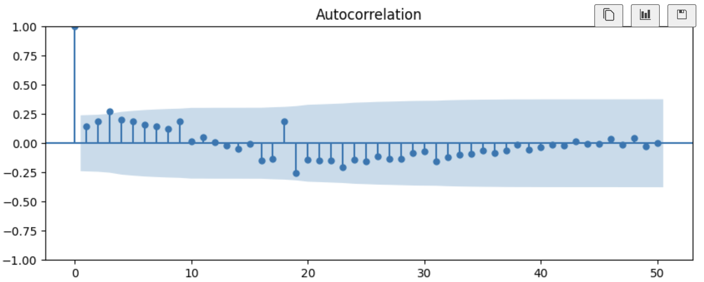
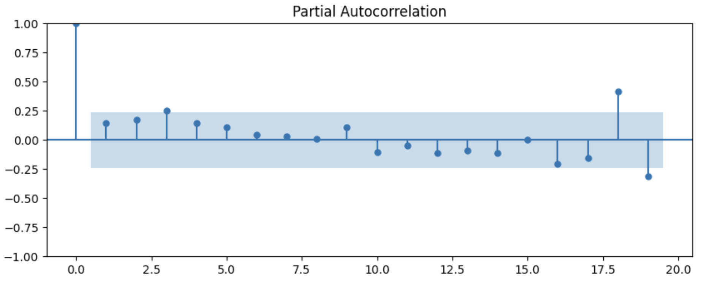
Model Building Autocorrelation Checking
8
Autocorrelation Checking
Autocorrelation Checking
Autocorrelation Function (ACF)
Partial Autocorrelation Function (PACF)
ACF
The ACF plot shows the correlation of a time series with its lagged values
PACF
The PACF plot, on the other hand, shows the correlation between the time series and its lagged values while controlling for the values at other lags
Hacktiv8

Slide 14
Model Building ARIMA and SARIMA
9
ARIMA
SARIMA
ARIMA model is a class of linear models that utilizes historical values to forecast future values. ARIMA stands for Autoregressive Integrated Moving Average, each of which technique contributes to the final forecast.
SARIMA stands for Seasonal-ARIMA and it includes seasonality contribution to the forecast. The importance of seasonality is quite evident and ARIMA fails to encapsulate that information implicitly.
Hacktiv8

Slide 15
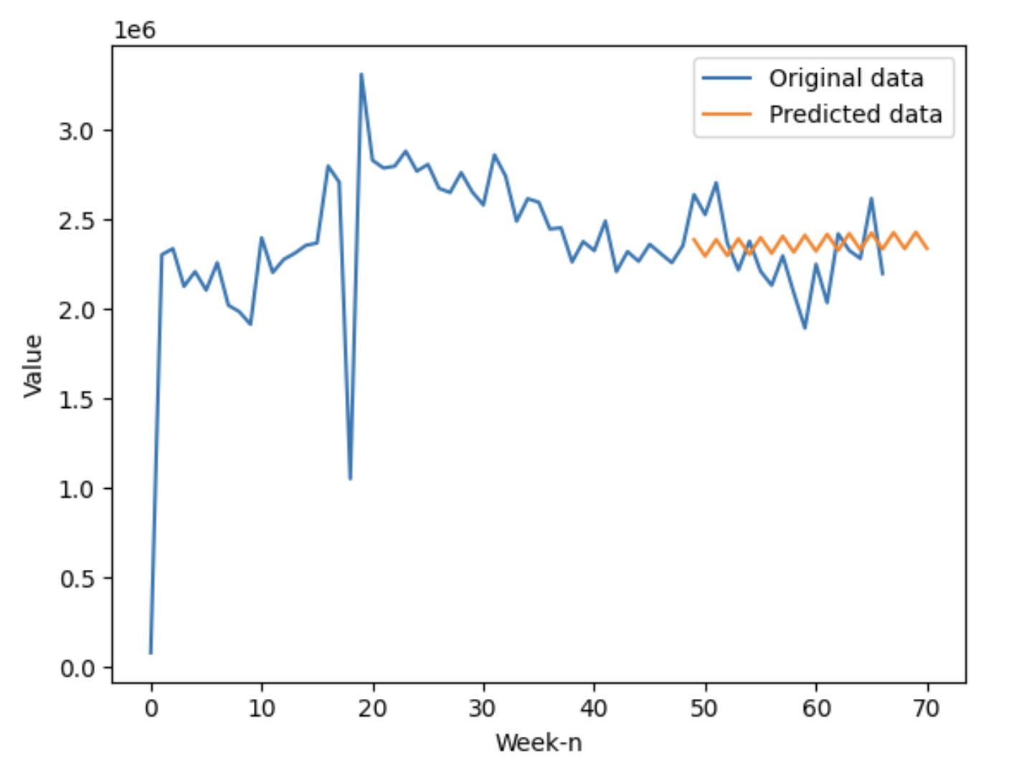
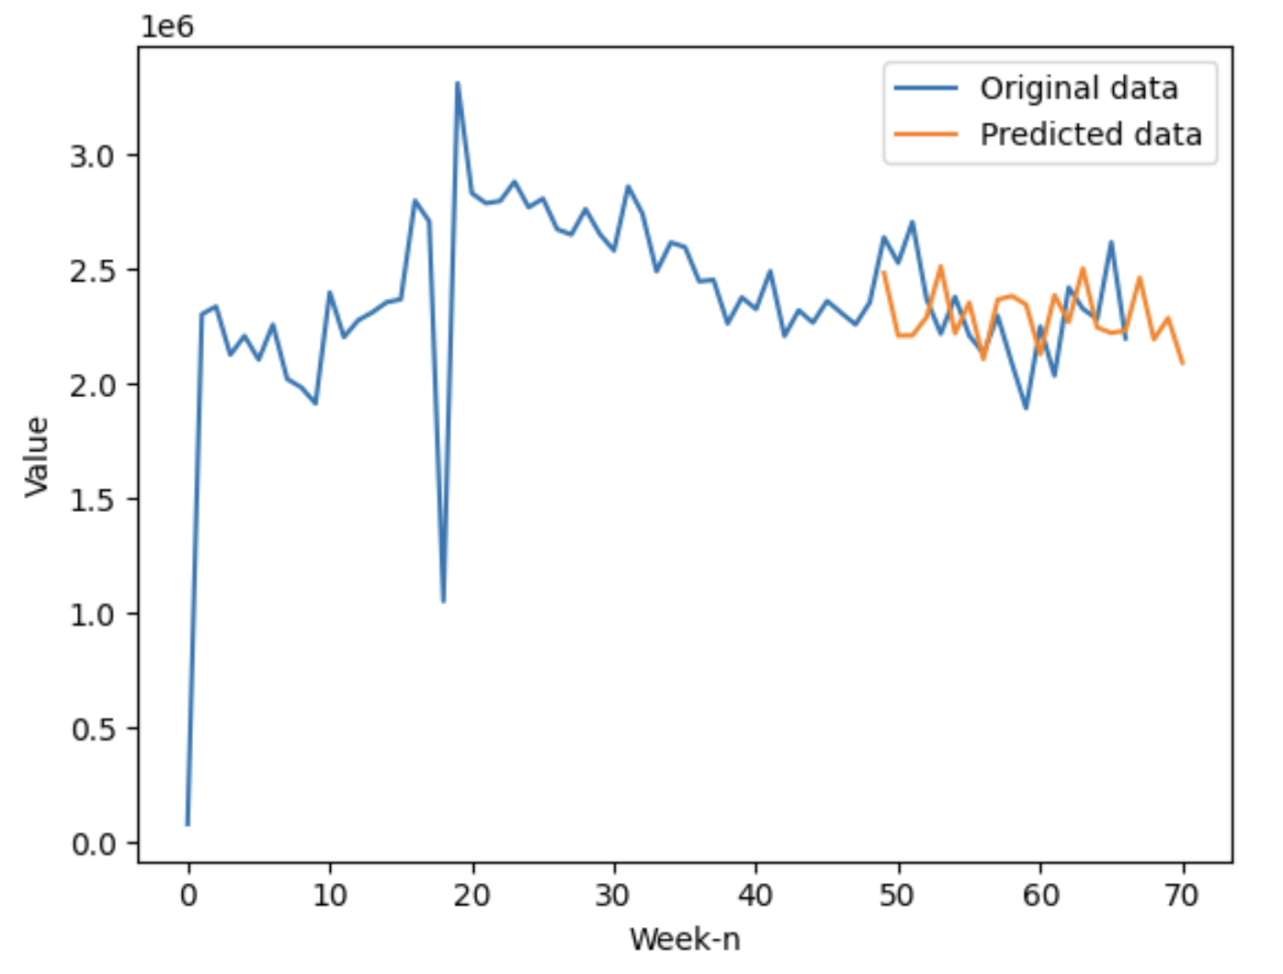
Model Result ARIMA model performs better than the SARIMA
10
ARIMA Model…
MAPE | 0.0788
MAE | 187024.83
RMSE | 222019.818
R2Score | -21.409
Based on MAPE indicator, the model’s prediction are off by 7.88% of the actual value, which is good but still need further improvement.
However the RMSE and R2Score suggest that model cannot capture the underlying patterns in the data
SARIMA Model…
Based on MAPE indicator, the model’s prediction are off by 9.01% of the actual value, which is worse than the ARIMA model
The RMSE and R2Score highly suggest that the model also cannot capture the underlying patterns in the data
MAPE | 0.0901
MAE | 208341.509
RMSE | 253398.77
R2Score | -3.669
Hacktiv8

Slide 16
Conclusion and Evaluation
11
Model Improvement…
… Model Conclusion
Model Selection : Hyperparameter Tuning Extension
Data Preprocessing : Missing and Outlier Value Handling
Feature Engineering : Add more features to the model, such as lagged variables and seasonal indicator combination
The model able to forecast the Paragon’s Sale Performance with the possibility of 7.88% error:
Hacktiv8

Slide 17
Hacktiv8

